Slide 1
Payroll Giving
Information from Hands On Payroll Giving

Slide 2
Hands On Payroll Giving
Family run Professional Fundraising Organisation dedicated to Payroll Giving, established in 1994
Free service to employers for Payroll Giving support with new or existing schemes
SSO integration with RGER platform
Office team based in Derbyshire, with nationwide team for onsite roadshow events
Work with all Payroll Giving Agencies, like Charitable Giving, Charities Trust and CAF
Funded by 120 of the UK’s top charities
Facilitate donations to any UK charity
We work with employers large and small
Notes:
Family run Professional Fundraising Organisation dedicated to Payroll Giving, 30 year this year. The longest running PFO!
Based in South Yorkshire and Derbyshire, we are the only PFO to have nationwide Face to Face fundraising coverage and innovative digital campaigns
Work with all Payroll Giving Agencies to assist employers
Registered with Fundraising Regulator
Free services to employers for Payroll Giving
Funded by 120 of the UK’s top charities
Facilitate donations to any UK charity
We work with employers and charities large and small

Slide 3
What is Payroll Giving?
Payroll Giving is a Government endorsed mechanism that allows PAYE employees to donate to charity directly from their salary, tax-free
The UK charity sector receives more than £128 million per year from over 500,000 employees giving via the scheme
Employees nominate to give any amount to any UK registered charity (or charities) from their pre-tax pay. Donations can be altered at any time, making Payroll Giving flexible and pertinent for all workforces
Payroll Giving is quick, easy, and free of charge for employers to set-up and run
Notes:
Payroll Giving is a government endorsed mechanism that allows PAYE employees to donate to charity directly from their salary
Since its launch in 1987, Payroll Giving has raised over £2 billion for charitable organisations across the UK. It provides an incredibly powerful platform for companies to support their employees’ giving.
The UK charity sector receives more than £128 million per year from over 500,000 employees giving via the scheme
Employees nominate to give any amount to any UK registered charity (or charities) from their pre-tax pay. Donations can be altered at any time, making Payroll Giving flexible and pertinent for all workforces
Payroll Giving is quick, easy, and free of charge for employers to set-up and run

Slide 4
Services Provided for Employers
SSO from RGER platform to employer branded online pages to with company logo, colours and corporate charity feature, example site: https://rger_example.hopg.co.uk/
Pages are secure, user-friendly and allow employees to start, amend and cancellation donations at any time. Data is captured and shared in line with payroll cut-offs.
Manage the end-to-end data flow with deduction reports sent via SmartPay.
Integrate with all Payroll Giving agencies on existing schemes, or offer simple registration and set-up for new schemes, free of charge.
Communication templates for sharing with employees.
Roadshow events and webinars during the year, plus feature promotions and competitions.
Helpline and email service for employee queries.
Notes:
The scheme only works with the backing of employers.
We can help employers become registered with a payroll giving agency, as well as to marketing, managing and increasing engagement.
Together we launch Payroll Giving to employees through internal communication channels, Dedicated online pages with company logo and relevant info, roadshow events, promotional visits.
Visits can be linked with other benefits to raise awareness of the entire benefit offering.
Employees join online or at an event with all data captured via Secure, user friendly joining pages.
We provide regular Communication templates for sharing with employees to raise awareness and get people taking about payroll giving.
Our 24/7 365 days a year helpline and email service, takes aware any burden of handling employee queries.
Some example portals we provide to National household names are linked in the slides.

Slide 5
Example Communications
Promotions and competitions during the year
Charity awareness campaigns
Employer webinars with charity partners
Matching Programmes
Bespoke materials to reflect employer messaging

Slide 6
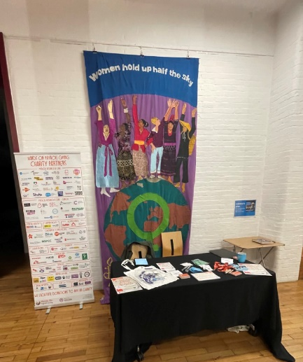
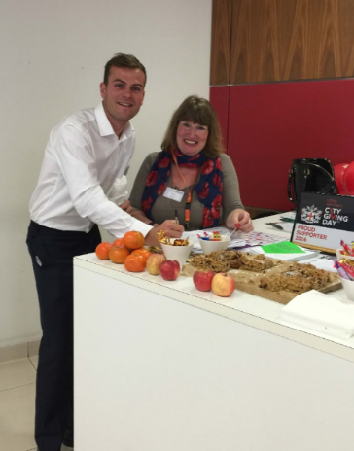
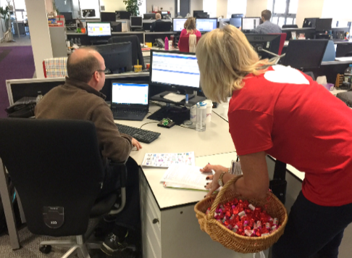
Roadshow events workplaces
Up to an 80% conversion rate from personal interactions with potential donors
Significantly boost engagement

Slide 7
MI Reporting Dashboard for Employers
HOPG Reporting Dashboard
Track progress to CSR goals
Login for named users
Employee data anonymised
Realtime information based on payroll deductions per period
Report showing supported charities each pay period

Slide 8
Employer Benefits of Payroll Giving
Direct support to charities and communities
Exposure for your charity partners
Boost employee engagement and improve organisational culture
Tangible demonstration of ethical business practices
Government recognised Quality Marks
Strengthens Corporate Social Responsibility
It’s free!
Notes:
From our services, there are direct employer benefits.
Direct support to charities and communities
Exposure for charity partners
Payroll Giving campaigns can be linked to corporate charity partners; bringing charities to a new audience increasing awareness and encouraging employee support.
Employee Engagement and Organisational Culture
Boosts employee engagement as a key employee benefit, empowering colleagues to engage with the causes that they care about most, creates a culture of compassion, giving and community support.
Tangible demonstration of ethical business practices
Payroll Giving is a practical, visible act of a company’s ethical commitment, reinforcing its reputation as a socially responsible entity that values the well-being of its employees, community, and the causes they care about
Government Endorsed Quality Mark
Government-recognised quality marks serve as a differentiator. Quality Marks are awarded to employers who operate Payroll Giving that provides external recognition for charity contributions
Strengthens Corporate Social Responsibility
Improves company image, enhances community involvement programmes, and support local communities.
The scheme can be implemented for free for employers!

Slide 9
Employer Testimonial
“We set up Payroll Giving for our 45,000 team members in 2017, it was an easy process and it’s simple to run. Our team have wholeheartedly embraced giving from their pay, with HOPG doing a brilliant job sharing the message across our 1,700 pubs, bars and restaurants across the UK.
We’re delighted to offer the scheme and would encourage any
other employers to provide it for their teams too, it’s a win win!”
LAUREN FARRELL
Reward & Policy Manager
Mitchells & Butlers
Notes:
Hugely dispersed workforce, we visit all locations to engage with employees across brands, levels and channels.
Employers love payroll giving!!
LAUREN FARRELL
Reward & Policy Manager
Mitchells & Butlers

Slide 10
Charity Benefits of Payroll Giving
An unrestricted source of regular income for the cause
No need to apply for Gift Aid, which saves money and time
Allows charities to receive the full tax relief
45% taxpayer £100 donation becomes £188 going to the charity
The average donation value is higher
Attrition is low, meaning payroll donors are likely to continue giving for longer
Notes:
For charities, Payroll Giving provides an unrestricted source of regular income for the cause.
When an organisations receives donations through Payroll Giving, there is no need to apply for Gift Aid, which saves them money and time. As opposed to Gift Aid where donations can only be increased by 25% regardless of the donor’s tax bracket, Payroll Giving allows charities to receive the full tax relief.
This is particularly beneficial for donations from higher-rate taxpayers – a 45% taxpayer can see a donation’s value increase by 88% meaning £100 out of the donor’s pocket becomes £188 going to the charity.
Another key benefit when comparing to Gift Aid is that the tax relief is available at point of donation, instead of having to be claimed later. The average donation value can be higher, the average monthly donation is over £22 and notably higher for those higher-value donors,
Attrition is lower than all other forms of regular giving, meaning payroll donors are likely to continue giving. On average, payroll givers give for up to 8 years.

Slide 11
Charity Testimonial
“Payroll Giving is a great source of income for charities. Regular gifts allow us to plan for the future and this is especially important in long-term research undertaken by Cancer Research UK.
As donations already include tax, we do not have to claim Gift Aid. Additionally, some employers match donations, enabling charities to do even more with these contributions.”
MERVI SLADE
Product & Programme Manager Payroll Giving Cancer Research UK
Notes:
Charities love payroll giving!!
MERVI SLADE
Product & Programme Manager Payroll Giving Cancer Research UK

Slide 12
Contact HOPG
Penny Tapping Digital & Operations Director 07736 063014
Penny@hopg.co.uk
Andrew Holmes
Business Support Manager
07900 373260
Andrew@hopg.co.uk
HOPG General Contact
Helpline: 01433 651972
Email support: askus@hopg.co.uk
Website: www.hopg.co.uk
LinkedIn: https://www.linkedin.com/company/hands-on-payroll-giving/
Facebook: https://www.facebook.com/HandsOnPG
Instagram: @handsonpg
X: @handsonpg

